Slide 1
Continuous-Time Fourier Transform
Introduction

Slide 2
The Topic
Continuous
Time
Discrete
Time
Fourier
Series
Discrete
Fourier
Transform
Periodic
Continuous
Fourier
Transform
Fourier
Transform
Aperiodic

Slide 3
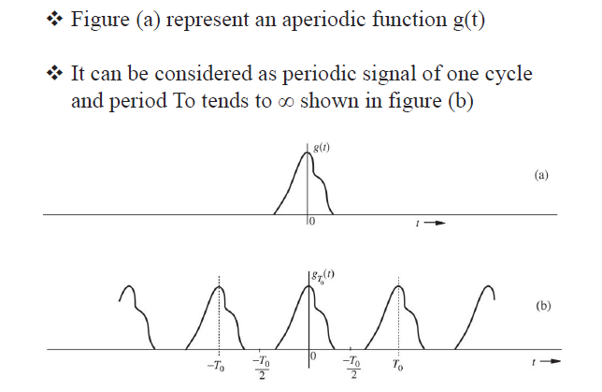
Introduction

Slide 4
Fourier Transform Pair
Inverse Fourier Transform:
Synthesis
Fourier Transform:
Analysis

Slide 5
Existence of the Fourier Transform
Sufficient Condition:
f(t) is absolutely integrable, i.e.,

Slide 6
Continuous Spectra
F_{I}(jω)
|F(jω)|
φ(ω)
Magnitude
F_{R}(jω)
Phase

Slide 7
Example
f(t)
1
t
-1
1

Slide 8
Example
f(t)
1
t
-1
1

Slide 10
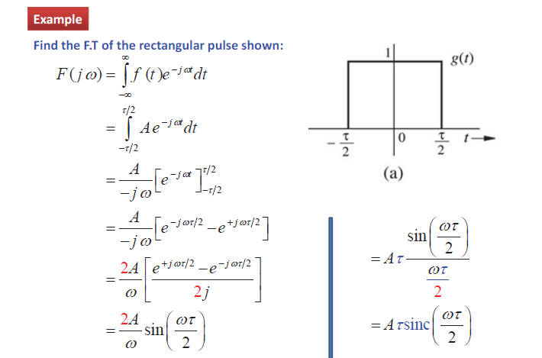

Slide 11
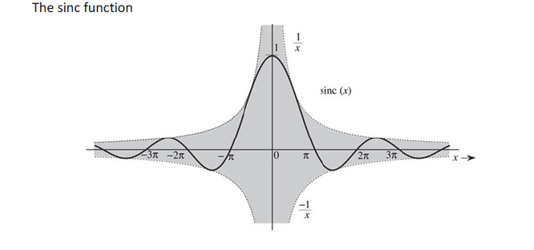

Slide 12
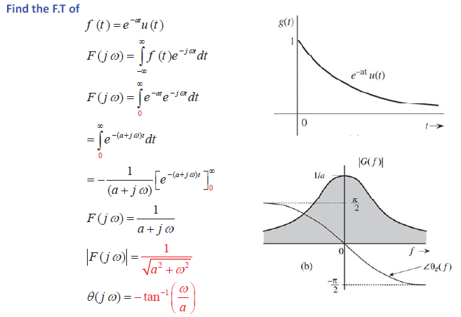
Example

Slide 13
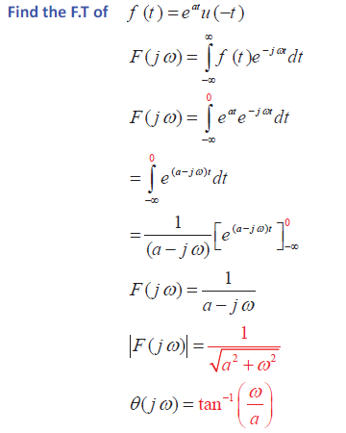

Slide 14
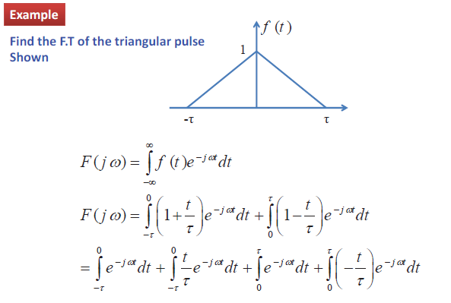
Complete …

Slide 15
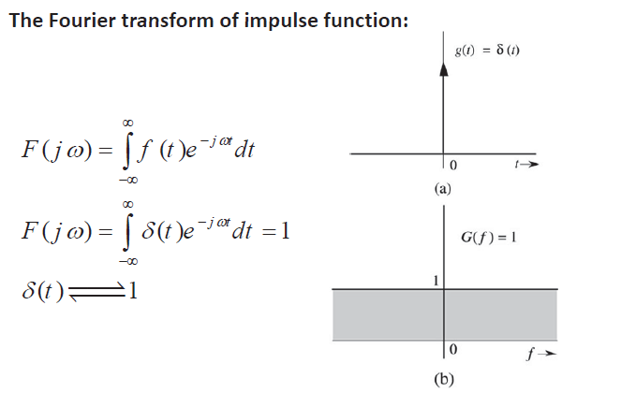
Example

Slide 16
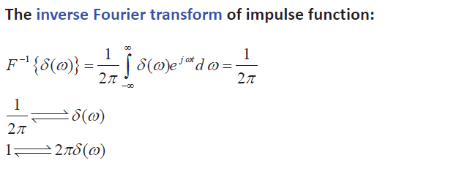

Slide 17
Continuous-Time Fourier Transform
Properties of
Fourier Transform

Slide 18
Notation

Slide 19
Linearity

Slide 20
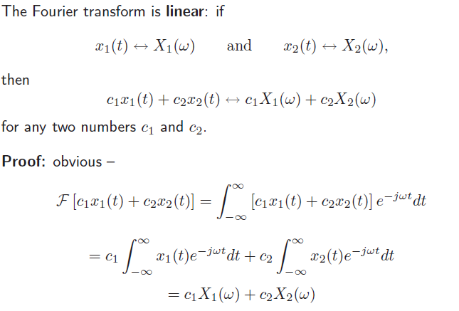

Slide 21
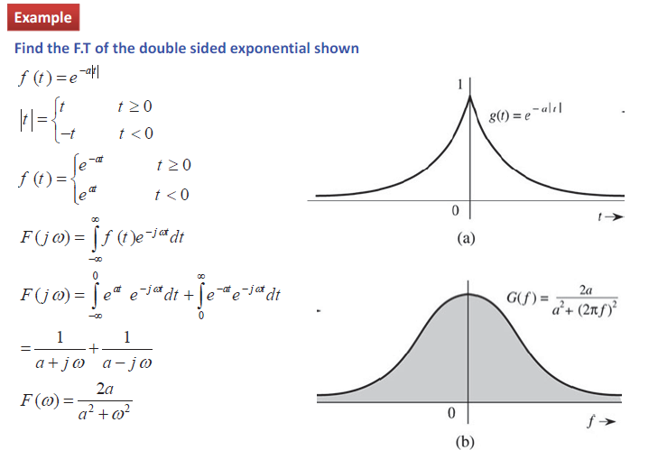

Slide 22
Time Scaling
Prove by yourselves
If f(t) = e^{-t} u(t)
If f(t) = e^{-at} u(t)

Slide 23
Time Reversal
Pf)

Slide 24
Time Shifting
Pf)

Slide 25
Frequency Shifting (Modulation)
Pf)

Slide 26
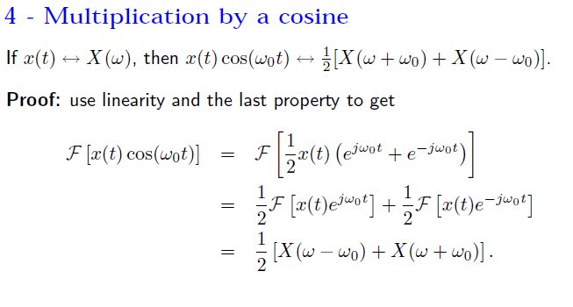

Slide 27
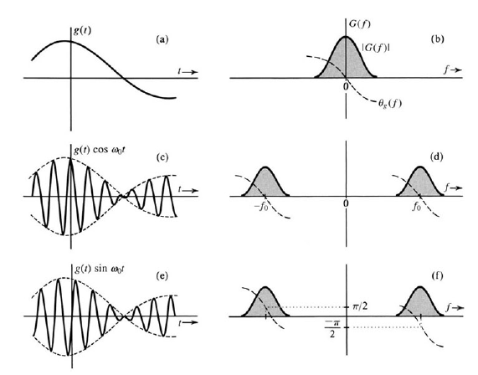

Slide 28
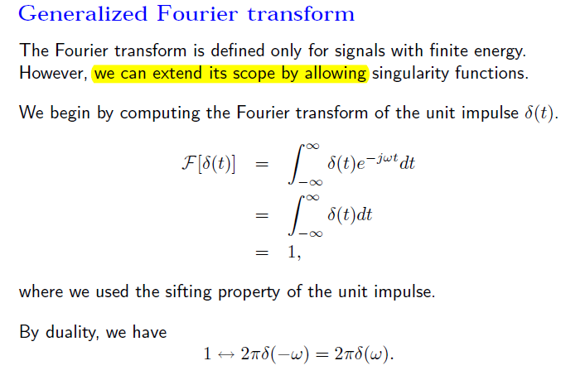

Slide 30
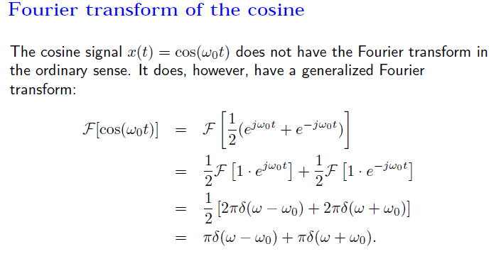

Slide 31
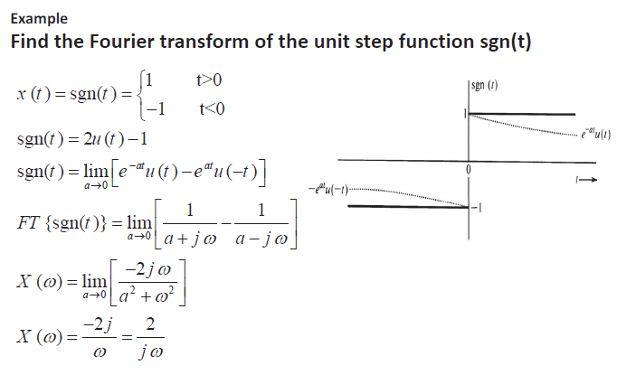

Slide 32
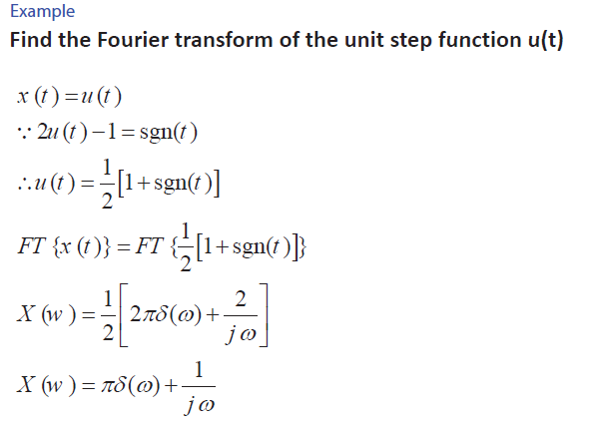

Slide 33
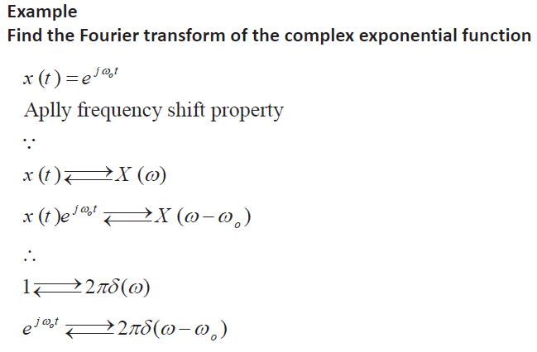

Slide 34
Example:
w_{d}(t)
f(t)=w_{d}(t)cosω₀t
1
t
t
−d/2
d/2
−d/2
d/2

Slide 35
Example:
w_{d}(t)
f(t)=w_{d}(t)cosω₀t
1
t
t
−d/2
d/2
−d/2
d/2

Slide 36
Fourier Transform of f’(t)
Pf)

Slide 37
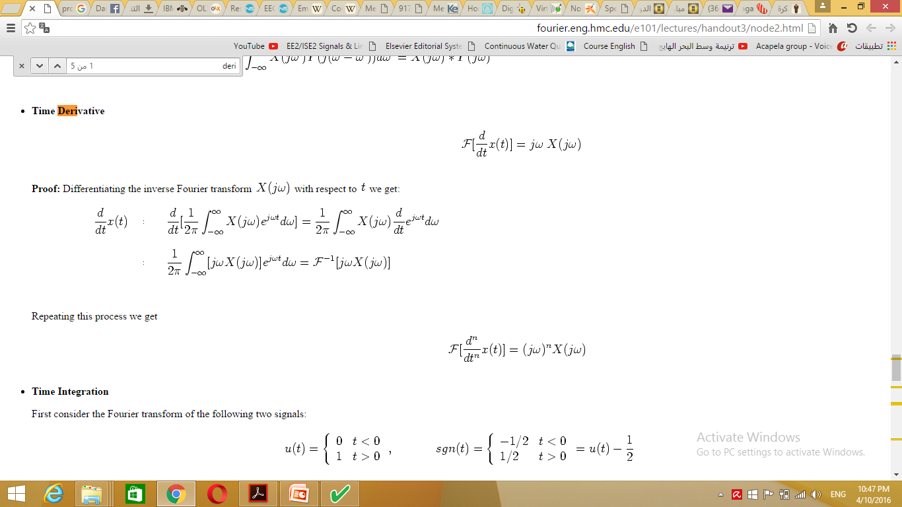

Slide 38
Fourier Transform of f ^{(n)}(t)
Proved by yourselves

Slide 39
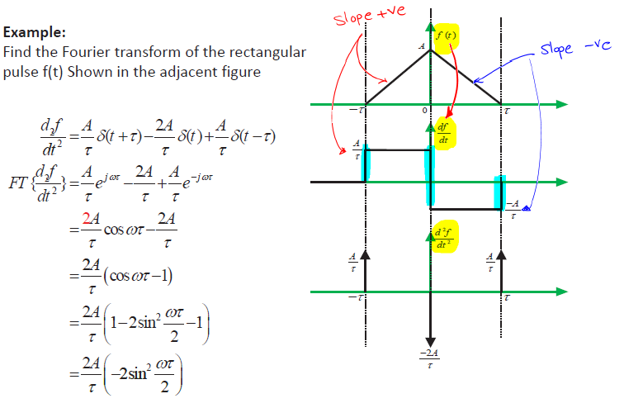

Slide 40
Remember

Slide 41
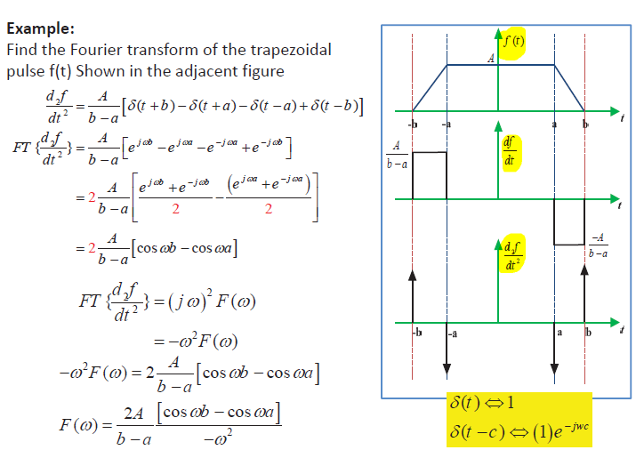
1

Slide 42
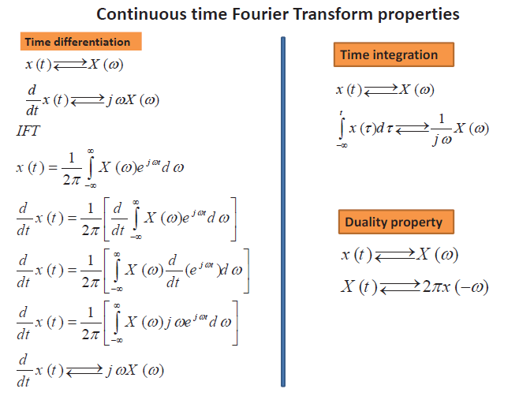

Slide 43
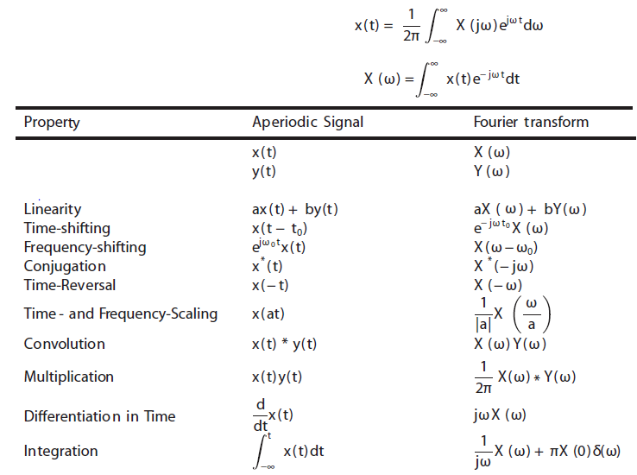

Slide 44
Continuous-Time Fourier Transform
Parseval’s Theorem

Slide 45
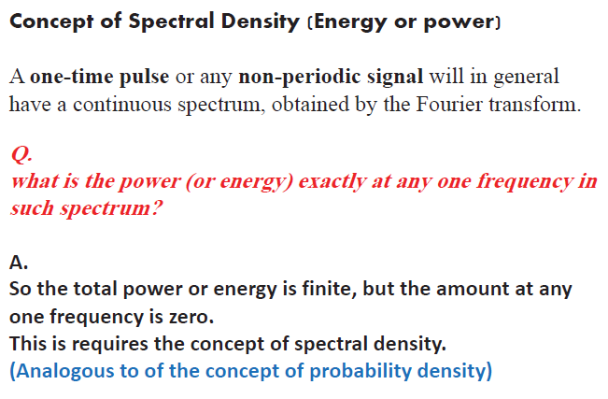

Slide 46
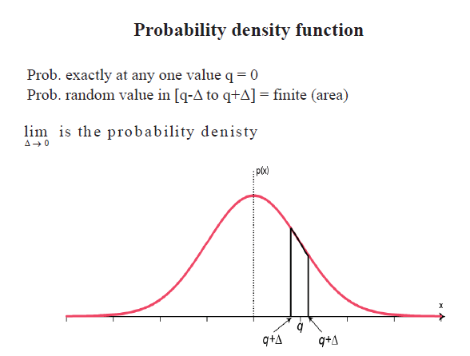

Slide 47
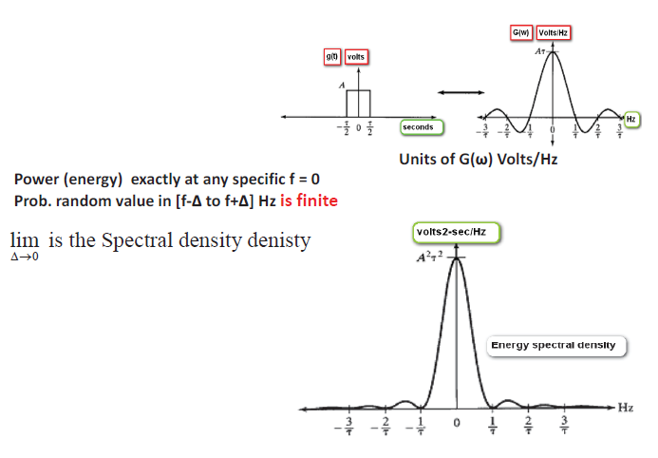

Slide 48
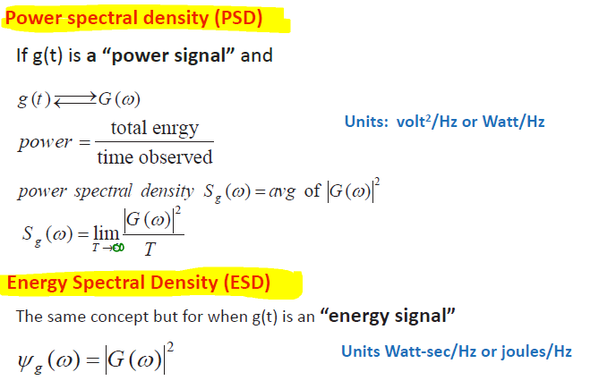

Slide 49
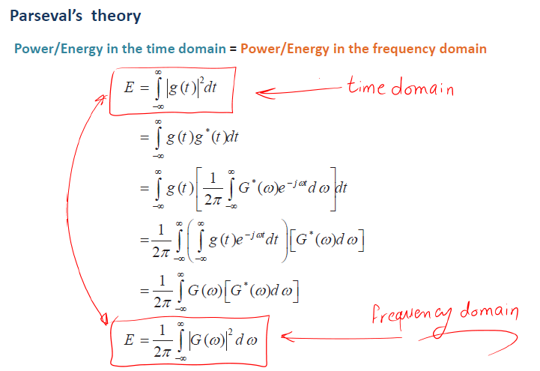

Slide 50
